Slide 1
EDFacts Consolidating and Using K-12 Performance Data within the U.S. Department of Education
Ross Santy
Director, Performance Information Management Service
U.S. Department of Education

Slide 2
What is EDFacts?
EDFacts is a U.S. Department of Education (ED) initiative to collect, analyze, report on and promote the use of high-quality, kindergarten through grade 12 performance data.
These data are used in education planning, policymaking, and management and budget decision-making to improve education programs.
EDFacts centralizes data provided by state education agencies (SEAs) on state, local education agency (LEA), and school demographics, program participation and performance outcomes.

Slide 3
What Was (How ED Collected Data)
OSEP
OESE
NCES
OCR
ED
Aggregate stats on participation in and compliance with Indivd. w/ Disabilities Act (IDEA) at the state level
Aggregate stats on participation in and compliance with Title programs in Elementary and Secondary Education Act (ESEA)
Aggregate stats on enrollment, graduation and dropouts. Plus school and district directory information. At the state, district and school levels
Aggregate stats on equitable distribution of services by gender and race/ethnicity . Collected directly from local education agencies
State ED Agencies
Surveys
Surveys
Surveys
Local ED Agencies
Local Student Information Systems

Slide 4
What Is (How ED Collects Data)
OSEP
OESE
NCES
OCR
ED
Aggregate stats on enrollment, graduation and dropouts, program participation and performance. Plus school and district directory information. At the state, district and school levels
Aggregate stats on equitable distribution of services by gender and race / ethnicity . Collected directly from local education agencies
State ED Agencies
State Longitudinal Data Systems (students)
Other State Systems
Local ED Agencies
Local Student Information Systems

Slide 5
Facts about EDFacts
EDFacts does not collect individual student- or staff-level information. All information provided to EDFacts is aggregated at the school, district, or state level. None of the information is personally identifiable to individual students or staff members.
The EDFacts Data Governance Board within ED meets monthly to address discrepancies in data definitions, address data quality issues and approve changes to the data set. The board includes official representatives from K-12 program offices across ED and reports up to the Secretary’s Policy Committee.

Slide 6
Types of Data Within EDFacts
General Information – School, District Directory, Charter Schools, Student and Staff Counts
Assessments – State assessment results in reading/language arts, math and science (general and alternate assessments)
Accountability – AYP Status, Determinations by subgroup, Improvement Status/Actions
Students with Disabilities (IDEA) – Child Count, Exiting, Discipline, Assessments, Removals, Staffing
ESEA Title I – School Improvement Grants, Public School Choice, Supplemental Ed Services, Student Participation, Staffing, Graduation Rates
ESEA Title III – Student Participation, English Language Attainment, Monitored Former LEP students
Career/Technical Education Concentrators (Perkins) – Secondary Indicators
Graduates/Completers, Dropouts, Teacher Quality, Computer Access, Homeless, Neglected or Delinquent, Migrant, Safe and Gun Free Schools

Slide 7
Key Steps in Getting Here
IDEA “618 Reporting” Congruency Studies (starting SY 2004-05)
Consolidated State Performance Report (starting SY 2004-05)
NCES Common Core of Data (starting SY 2006-07)
EDFacts Regulation (January 2007)
Perkins CAR (2011)

Slide 8
Primary Goal for EDFacts
Help the policy and program offices to make better use of the one set of data
Prior data uses had been based entirely at the SEA level of data
Accountability under NCLB led to reporting and use of LEA and school level data
Program office capability was not built around availability of LEA and school level data
Data review and validation became a key process hurdle
Notes:
Group of ~70 analysts across ED principal offices
Capacity building activities
Formal training on data structure and report building
Hands-on data labs and continuous needs assessment around reporting
Monthly ad-hoc user group meetings
Empowering data use by supporting “lead users”
EDFacts as an enterprise information system at USED
Partners in data management

Slide 9
Uses of EDFacts Data
Generating the NCES Common Core of Data and other public data
State and Congressional District Profiles
Data “exploration” as part of policy analysis and policy development process
Powering evaluations and studies with data reported to EDFacts

Slide 10
Public Data

Slide 11
http://nces.ed.gov/ccd

Slide 12
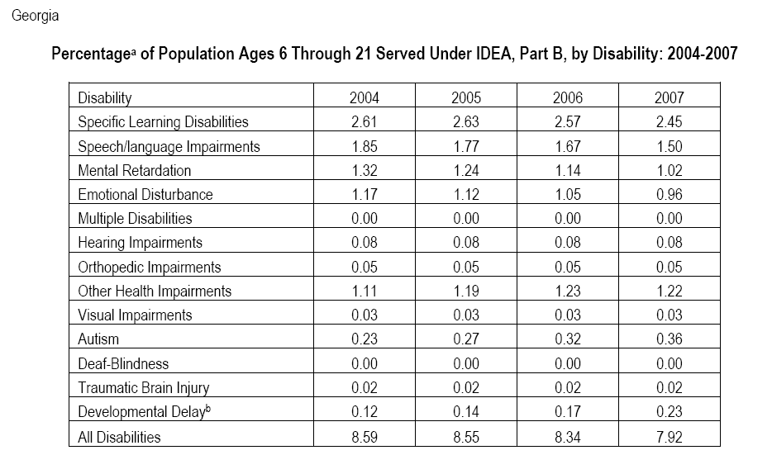
http://www.ideadata.org

Slide 13
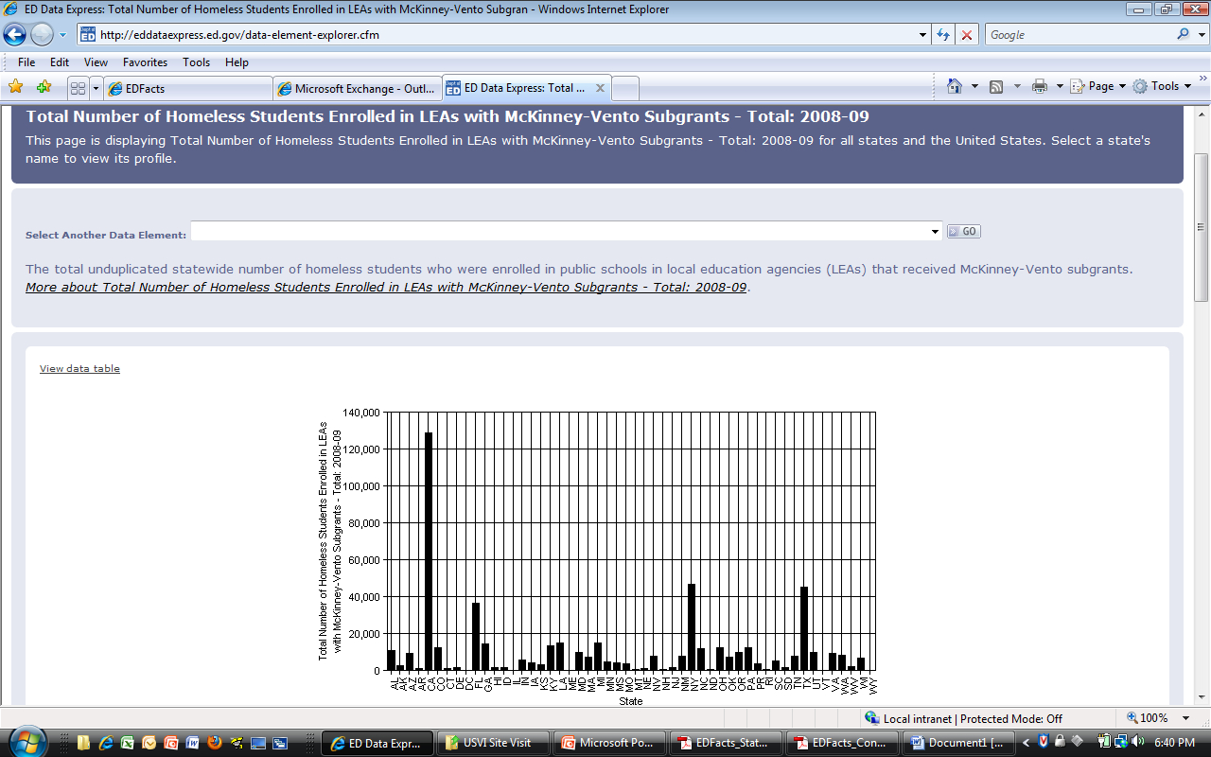
http://eddataexpress.ed.gov

Slide 14
Profiles

Slide 19
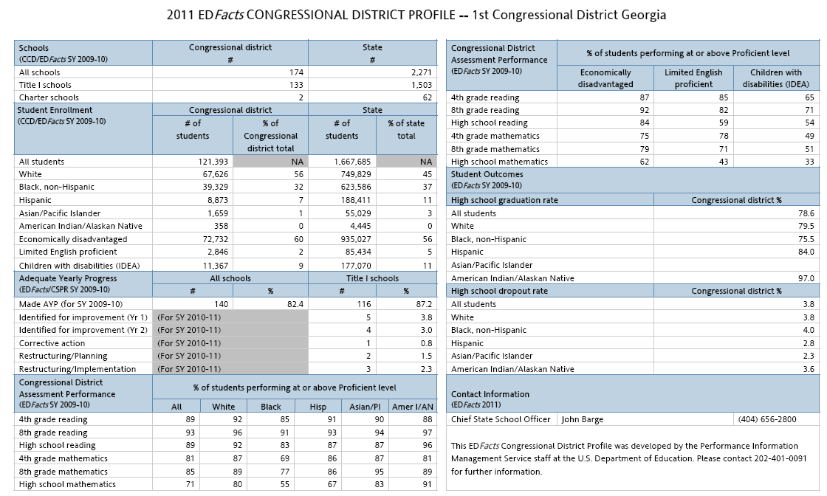

Slide 20
Data “Explorations”

Slide 21
Question: How many Hispanic students participate in ED programs?

Slide 22
Transitioning Reporting by Race/Ethnicity

Slide 23
Evaluations and Studies

Slide 24
Internal Data Quality: Title I Participation
2 Data Groups on Title I Participation:
Data Group 548: The cumulative unduplicated number of students participating in and served by Title I of ESEA, Part A, Sections 1114 (Schoolwide Programs (SWP)) and 1115 (targeted assistance (TAS) programs). By Race/Ethnicity and subgroups
Data Group 670: The cumulative unduplicated number of students participating in and served by programs under Title I, Part A of ESEA as amended.
 | 548 |  |  |  |  |  |  |  |  |  |  | 670
 | Asian or Pacific Islander | Black (not Hispanic) | White (not Hispanic) | American Indian or Alaska Native | Hispanic | Asian | Black | Native Hawaiian or Other Pacific Islander | Two or more races | White | DG 548 Grand Total | DG 670 Grand Total
ALABAMA | 1488 | 108932 | 158510 | 3392 | 15246 |  |  |  |  |  | 346320 | 288354
ALASKA |  |  |  | 21882 | 2752 | 2937 | 1932 | 1288 | 3063 | 18679 | 52533 | 39927
ARIZONA | 5430 | 20462 | 60271 | 13951 | 174816 |  |  |  |  |  | 274930 | 280191
ARKANSAS |  |  |  | 1786 | 24588 | 2855 | 60509 | 1177 | 3312 | 160794 | 255021 | 268650
BUREAU OF INDIAN EDUCATION |  |  |  |  |  |  |  |  |  |  |  | 47740
CALIFORNIA |  |  |  | 30371 | 2266744 | 239268 | 297161 | 31027 | 57369 | 495966 | 5220212 | 3475321
COLORADO | 3749 | 13998 | 54200 | 2786 | 95154 |  |  |  |  |  | 169887 | 201355
CONNECTICUT | 3174 | 29845 | 28775 | 441 | 39253 |  |  |  |  |  | 128745 | 102117
DELAWARE | 1869 | 24370 | 28353 | 235 | 9254 |  |  |  |  |  | 64081 | 64081
DISTRICT OF COLUMBIA | 766 | 52278 | 1738 | 28 | 8705 |  |  |  |  |  | 63542 | 61158
FLORIDA | 22021 | 400711 | 362282 | 4209 | 423428 |  |  |  |  |  | 1250205 | 1253286
GEORGIA |  |  |  | 1987 | 123263 | 15809 | 433213 | 775 | 23648 | 291785 | 890480 | 885986
HAWAII | 85951 | 2372 | 19650 | 762 | 5441 |  |  |  |  |  | 114187 | 125077
IDAHO | 1249 | 1282 | 75578 | 2071 | 24279 |  |  |  |  |  | 104459 | 101641
ILLINOIS | 14945 | 227386 | 167572 | 1332 | 256872 |  |  |  |  |  | 682151 | 694064
INDIANA | 2551 | 52880 | 115898 | 706 | 27770 |  |  |  |  |  | 212678 | 219173

Slide 25
Internal Data Quality: Title I Participation
 | DG 548 |  |  |  |  |  |  |  | DG 670 | % Difference 548 and 670
 | American Indian or Alaska Native | Asian | Black | Hispanic | Native Hawaiian or Other Pacific Islander | Two or more races | White | Grand Total (DG 548) | Grand Total (DG 670)
GA LEA 1 | 1 | 24 | 614 | 353 |  | 50 | 1431 | 2473 | 2341 | 5.6%
GA LEA 2 | 1 |  | 260 | 491 |  | 15 | 589 | 1356 | 1236 | 9.7%
GA LEA 3 | 1 | 5 | 277 | 162 |  | 51 | 1049 | 1545 | 1432 | 7.9%
GA LEA 4 |  | 3 | 304 | 37 |  | 3 | 67 | 414 | 386 | 7.3%
GA LEA 5 | 7 | 66 | 3664 | 111 |  | 138 | 1772 | 5758 | 5721 | 0.6%
GA LEA 6 | 1 | 25 | 48 | 151 |  | 37 | 1958 | 2220 | 2192 | 1.3%
GA LEA 7 | 27 | 240 | 942 | 1024 | 4 | 334 | 3808 | 6379 | 6100 | 4.6%
GA LEA 8 | 16 | 79 | 789 | 974 | 3 | 222 | 6829 | 8912 | 8557 | 4.1%
GA LEA 9 | 6 | 19 | 1073 | 285 |  | 48 | 1222 | 2653 | 2475 | 7.2%
GA LEA 10 | 4 | 10 | 309 | 217 |  | 52 | 1931 | 2523 | 2403 | 5.0%
GA LEA 11 |  | 15 | 420 | 26 |  | 33 | 856 | 1350 | 1195 | 13.0%
GA LEA 12 | 6 | 7 | 54 | 68 | 1 | 22 | 2647 | 2805 | 2645 | 6.0%
GA LEA 13 |  | 1 | 41 | 4 |  | 6 | 304 | 356 | 356 | 0.0%
GA LEA 14 | 3 | 11 | 1328 | 241 | 4 | 70 | 949 | 2606 | 2479 | 5.1%
GA LEA 15 | 5 | 13 | 450 | 36 | 1 | 51 | 1520 | 2076 | 1974 | 5.2%
GA LEA 16 | 1 | 41 | 331 | 698 |  | 58 | 886 | 2015 | 1998 | 0.9%
GA LEA 17 | 13 | 90 | 2743 | 362 | 10 | 244 | 4344 | 7806 | 7999 | -2.4%
GA LEA 18 | 13 | 10 | 3341 | 4 | 2 | 78 | 1630 | 5078 | 4735 | 7.2%
GA LEA 19 | 4 | 14 | 837 | 88 |  | 85 | 1768 | 2796 | 2756 | 1.5%
GA LEA 20 | 8 | 54 | 296 | 1079 | 12 | 62 | 2164 | 3675 | 3467 | 6.0%
GA LEA 21 | 1 | 2 | 675 | 29 |  |  | 25 | 732 | 710 | 3.1%
GA LEA 22 | 38 | 76 | 1429 | 324 | 22 | 346 | 4015 | 6250 | 6056 | 3.2%
GA LEA 23 |  | 18 | 656 | 361 |  | 69 | 1094 | 2198 | 2039 | 7.8%
GA LEA 24 | 15 | 24 | 1330 | 652 | 6 | 481 | 5413 | 7921 | 7329 | 8.1%
GA LEA 25 | 4 | 30 | 766 | 399 |  | 146 | 1084 | 2429 | 2220 | 9.4%

Slide 26
Recent Studies to Use EDFacts Data
NAEP/State Assessment Alignment Study (IES)
IDEA Participation and Educational Environments (IES)
IDEA Services and Charter Schools (GAO)
Use of Census Versus State Reported Data within the Title III Funding Formula (ED)

Slide 27
What is USED doing to help educational data quality?
Clarify definitions
NCES Handbooks
EDFacts File Specs and Guidance
Enable the automation of vertical reporting
Promote Interoperability
EDFacts Coordination Task Orders
Linkages between SLDS and EDFacts
Work with the community to promote high-quality standards
Common Education Data Standards (CEDS v2.0)

Slide 28
Impact of Longitudinally Linked ‘Microdata’
States have longitudinal student data
Significant development since 2003 when site visits were performed
Program measures under current ESEA developed from a snapshot/survey frame of reference
State Fiscal Stabilization Fund
States ensure public access to longitudinal statistics by 9/30/2011 (K-12 grads enrolling in higher education)
Growth provisions of ESEA proposals also consider a longitudinal perspective

